Slide 1
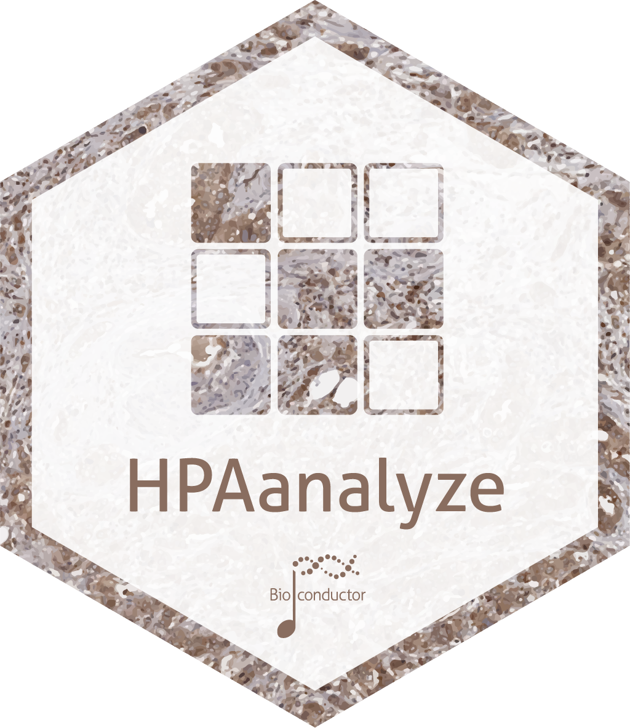

Writing a (very niche) R package for reproducible data analysis from a public dataset
Anh N. Tran
Postdoc at Northwestern U.
@anh_n_tran
trannhatanh89
SatRday Chicago, April 27, 2019

Slide 2
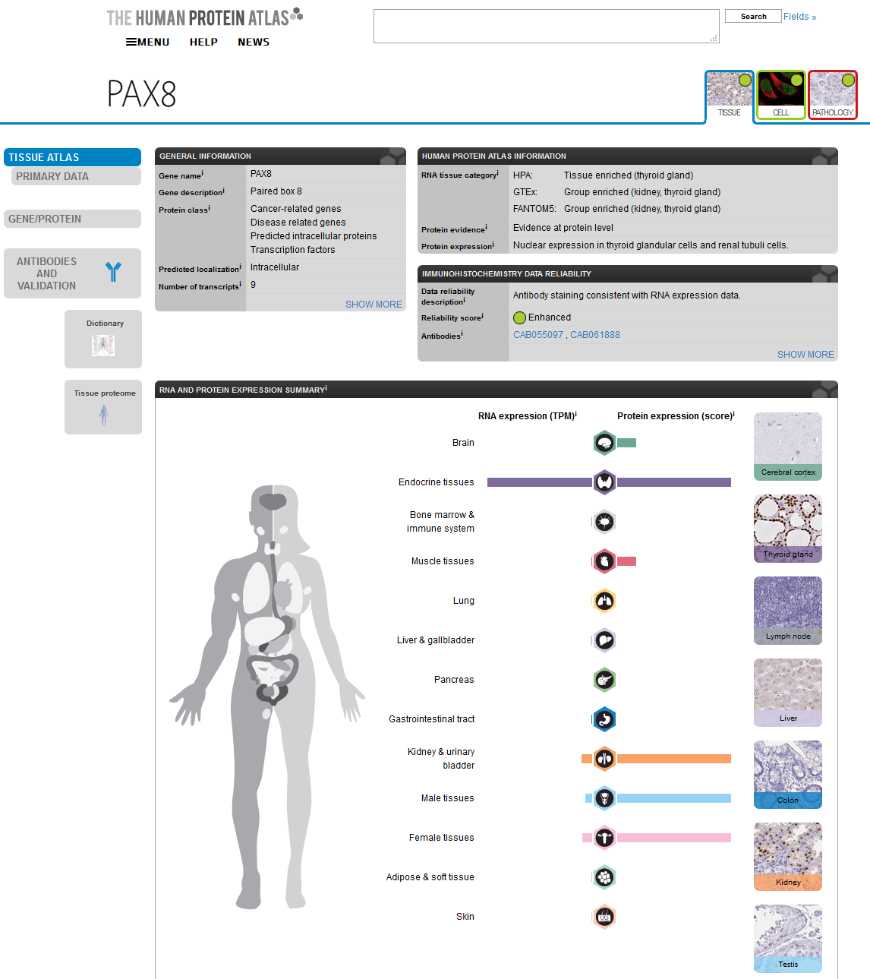
Full of info, but untidy
Graphs are pretty, but not publication
quality
Hard to retrieve data for reproducibility
www.proteinatlas.org

Slide 3
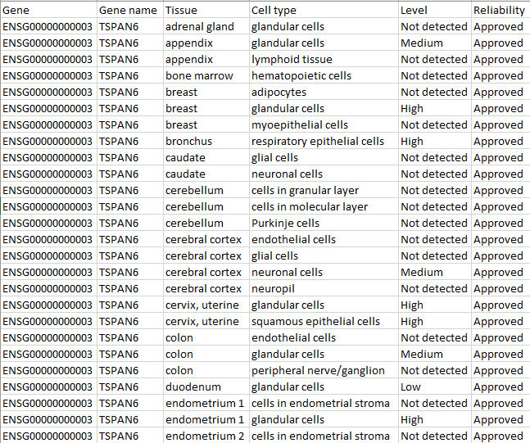

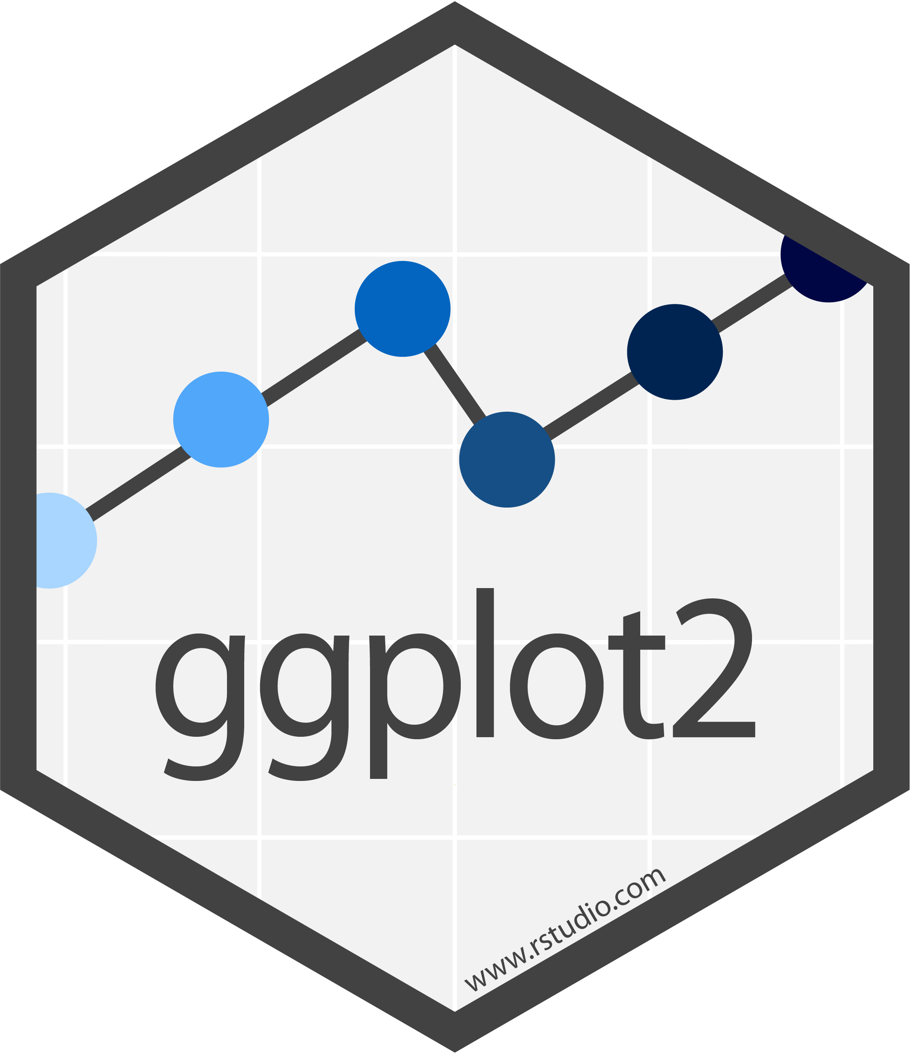


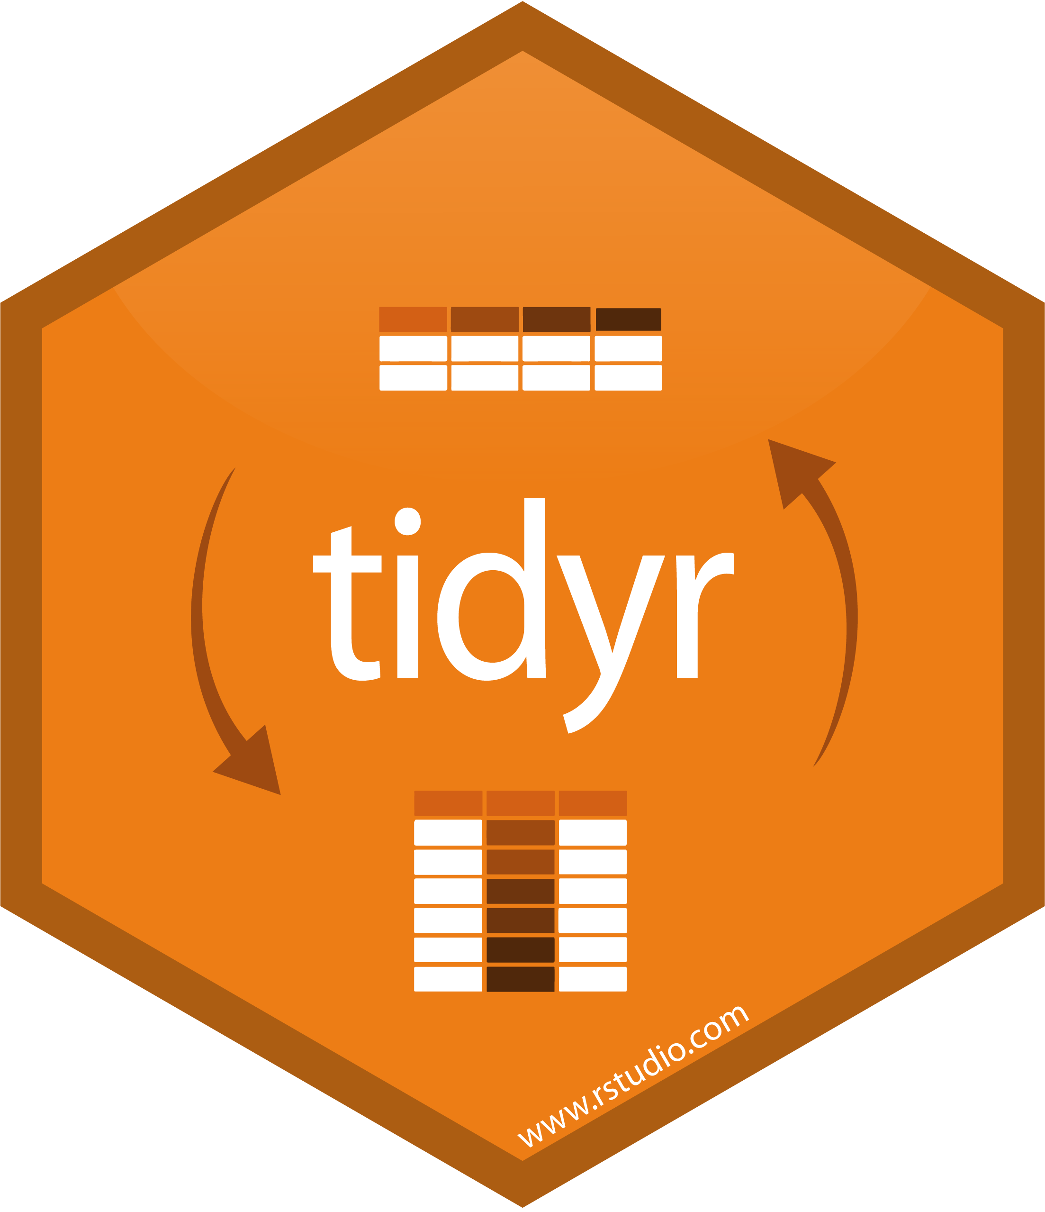
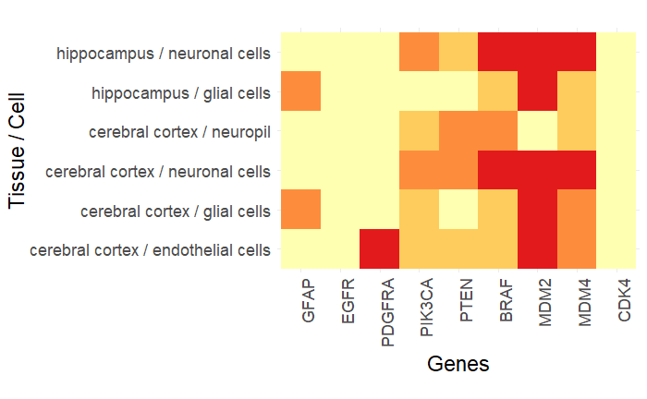
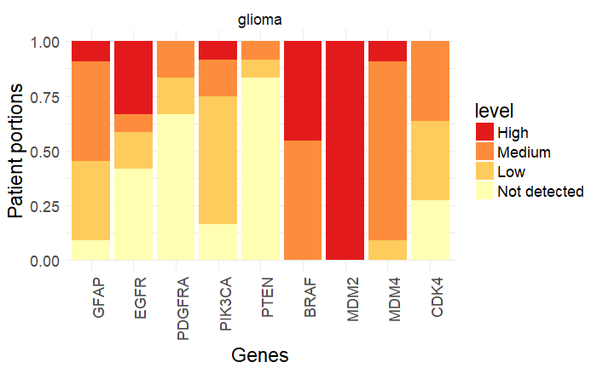
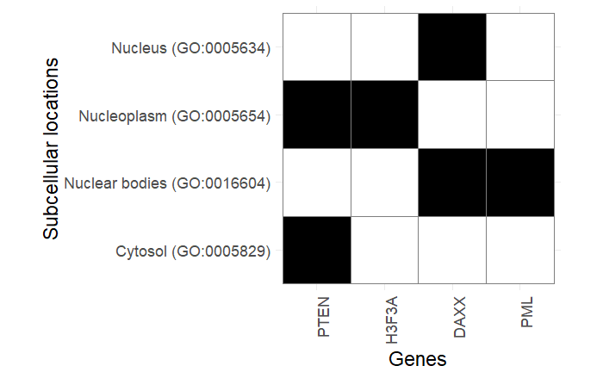
Summarized data provided as .tsv
openxlsx

Slide 4
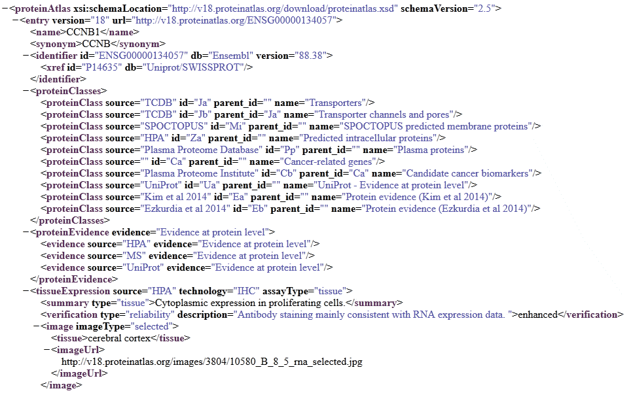
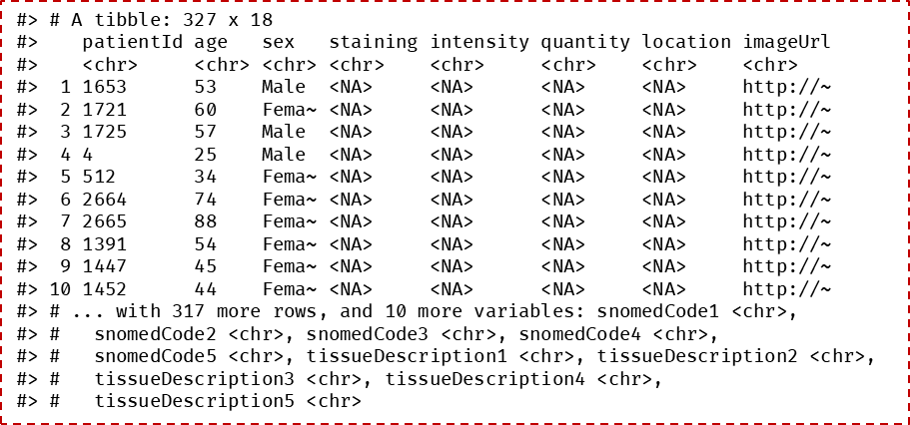
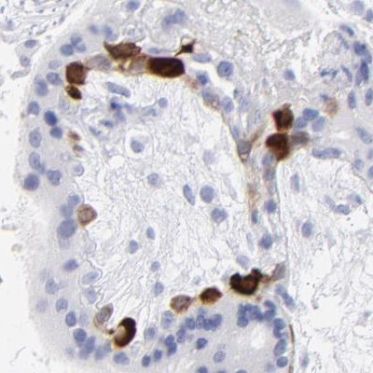
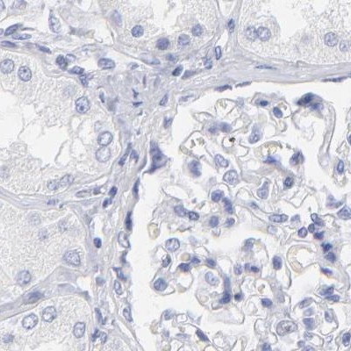
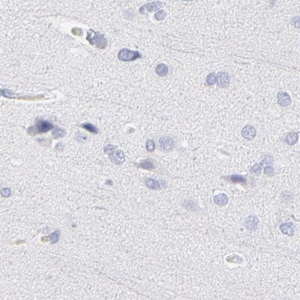
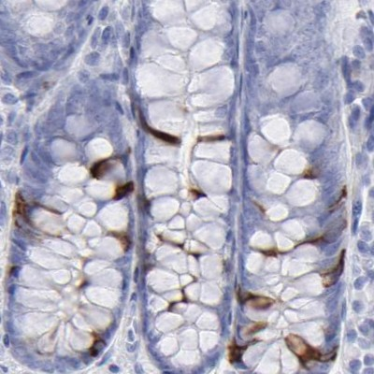
Full datasets provided as .xml(s)
xml2

Slide 5
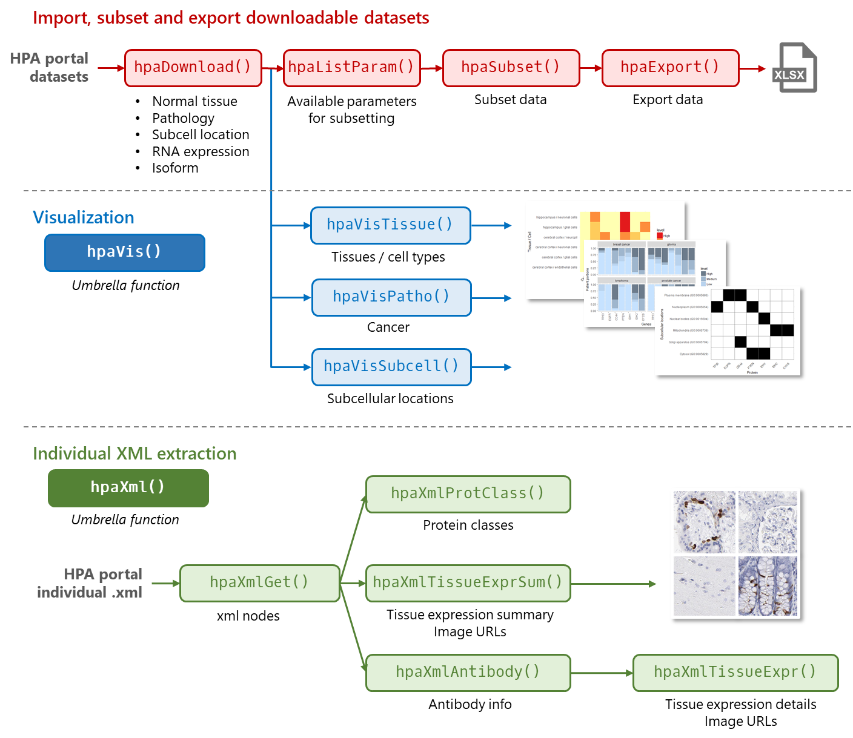

Slide 6
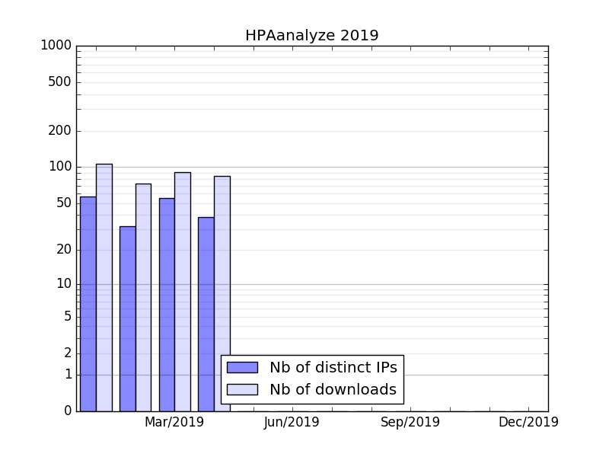
You’re welcome, my 50 users!
http://bioconductor.org/packages/stats/bioc/HPAanalyze/ (April 26, 2019)

Slide 7
It’s kinda lonely in the niche…
Issues may go unreported
Hard to get user feedbacks
and no community support
Advanced functionalities
may not worth it
Hex sticker never gets printed ☹

Slide 8
It’s kinda lonely in the niche…
Issues may go unreported
Submit to a repository for review
Continuous integration
Hard to get user feedbacks
and no community support
Local beta testers
Reach out via social media
Approachable vignettes/README
Advanced functionalities
may not worth it
Vignettes for advanced use cases
Hex sticker never gets printed ☹
☹

Slide 9








Acknowledgement
openxlsx
reshape2
xml2
Thank you!
cowplot
NOPE!!!

